Slide 1

VISVESVARAYA TECHNOLOGICAL UNIVERSITY
BELAGAVI , KARNATAKA-590 018

Slide 2

VEMANA INSTITUTE OF TECHNOLOGY. KORAMANGALA BANGALORE.
DEPARTMENT OF CIVIL ENGINEERING
BEHAVIOUR OF FIBER REINFORCED CONCRETE USING DEMOLITION WASTE.
GUIDED BY
SATHISH G.A
ASSOCIATE PROFESSOR
VEMANA INST OF TECH.
BATCH MEMBERS
AKHIL M 1VI16CV002
SIREESH G 1VI16CV042
N LOHITH REDDY 1VI16CV048
DHANUSH R 1VI18CV403

Slide 3
CONTENTS.
Abstract.
Introduction.
Literature.
Materials and methodology.
Tests.
Results and conclusion.
Schedule of laboratory works.
Material cost.
References.

Slide 4
ABSTRACT
Use of conventional concrete has been rapidly increased in past decades. Due to durability problems and remodeling of structures large quantity of demolition waste are generated and also during construction concrete waste are generated.
Disposal of these wastes causes environmental impact. These waste has to be recycled and used in construction to avoid environmental problems.

Slide 5
In this study an attempt has been made to design M25 concrete using concrete demolition waste and fibers are included with different percentages and the behaviour of demolition waste fiber reinforced concrete is studied.
The results of compressive test, split tensile test and flexural test with fibers in demolition waste is compared with demolition waste without fibers.

Slide 6
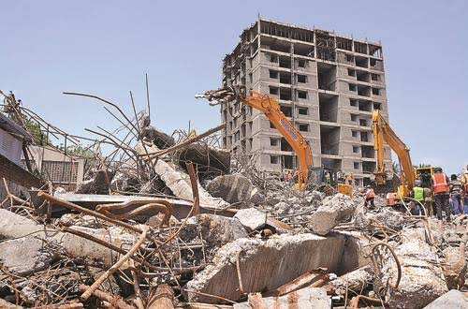
CONSTRUCTION AND DEMOLITION WASTE
INTRODUCTION.
About 3 billion tones concrete construction demolition waste is generated annually over the globe and 14.5 million tones in India .
The demolition waste disposal are difficult to manage.
Concrete waste can be recycled and reused as aggregates.

Slide 7
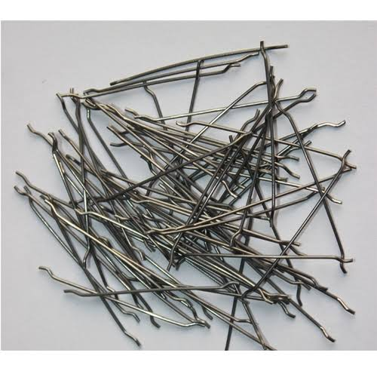
FIBER REINFORCED CONCRETE
Fibers are natural, polymeric and metallic.
steel fiber of different aspect ratio are available.
Addition of steel fibers to concrete can increase tensile and flexural strength.

Slide 8
SCOPE
To collect concrete demolition waste and to reuse matrix for steel fiber reinforced concrete .

Slide 9
OBJECTIVES.
Collection and segregation of concrete demolition wastes.
Processing of concrete demolition waste.
Characterization of concrete demolition waste for coarse aggregate and fine aggregate .
Proportioning of M25 concrete with concrete demolition waste for 50mm slump by trial.
Addition of steel fibers with 1%, 2% and 3% by weight of concrete and to cast cubes beams, cylinders.
To determine Compressive strength ,Tensile strength and Flexural strength , using concrete demolition waste, with and without steel fibers.
Cost analysis and conclusion.

Slide 10
LITERATURE.
MEENU LATHA GOYAL , in paper titled ‘Deconstruction and material reuse”. [Urban-ACE-2019],“A process of carefully dis-assembling a structure so that the material used during the initial construction can be given a second life”.
Chanki Nasirhusen M'. Dr. Jayeshkumar R. Pitroda, , in their Paper titled, “A critical review on construction waste management”,[2018],“Construction industry produced a large quantity of waste which is harmful environmentally and costly for budgeting the project. So waste management is important for construction industry”.
Dept of civil eng.VIT

Slide 11
Sastry K, Suresh B, in their Paper, ‘Experimental study of fiber reinforced concrete waste with recycled aggregates, [2018],“Material properties of fibre reinforced concrete in which the natural stone aggregates partially replaced by recycled aggregates concrete. The combination of recycled construction and demolition waste, steel steel fibers and binder creates an unusual fiber reinforced concrete: new composite, which offers a wide field of possible use in construction industry”.
, Gourav Gupta'. Sameer Malhotra,in their Paper, “A case study on fiber reinforced concrete”,[2018],“Using fibers in concrete to improve resistance to cracking and fragmentation is old and intuitive, polypropylene fiber used for reinforcing concrete mixes and to obtain basic strength, polypropylene fiber considerably increases the tensile strength as the fiber content is increased”.

Slide 12
Ankur Yaday'. Satish Parihar,in their Paper, “A review on steel fiber reinforced concrete”,[2018],“Fibers have the property to enhance the toughness of concrete. It is found that Steel fiber reinforced concrete have superior resistance to cracking so the intention behind the increasing usage of SFRC is to increase the toughness and to reduce the crack deformation characteristics”,
Pramod Kawde , Abhijit Warudkar,in their Paper, “Steel fiber reinforced concrete A review”,[2017],“Internal micro cracks which are mainly responsible for brittle failure of concrete, fibers added in specific percentage to concrete improves the mechanical properties, durability and serviceability of the structure”.

Slide 13
SUMMARY.
Only few papers are published with respect to construction demolition waste and fiber reinforced concrete.
From the literature available, the demolition waste are segregated, cleaned, characterized for coarse aggregate and fine aggregate.
Fibers included on concrete have shown only marginal increase of compressive, flexure and tensile strength due to quality of segregation done and proportioning.

Slide 14
MATERIAL & METHODOLOGY.
Materials
Cement : Ordinary Portland cement of grade 43.
Fine aggregate : Crushed demolition waste passing 4.75mm IS sieve.
Coarse aggregate : Segregated aggregates retaining 4.75mm IS sieve and passing 20mm IS sieve.
Water : Required amount of water by trial.
Super plasticizers : Gelium.
Fiber : Steel fibers of diameter 0.5mm with aspect ratio of 50.

Slide 15
Quantity estimation of materials required.
OPC cement grade 43 = 125 kg.
Fine aggregate = 135 kg.
Coarse aggregate = 280 kg.
Super plasticizer (gelium) = 1 liter.

Slide 16
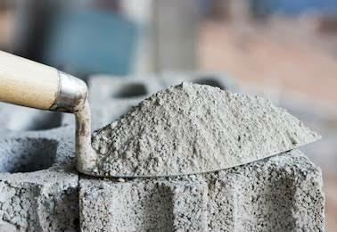
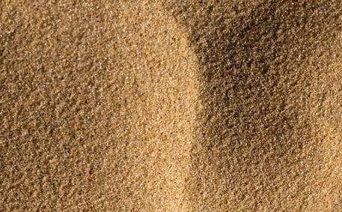
TESTS ON MATERIALS.
CEMENT
Normal consistency.
Initial setting time.
Specific gravity.
FINE AGGREGATE
Fineness modulus and zoning.
Specific gravity.

Slide 17
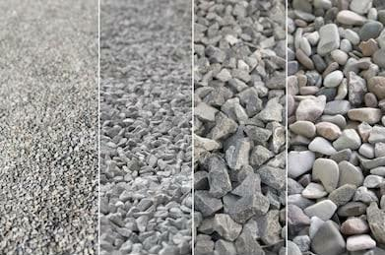
COARSE AGGREGATE
Fineness modulus and grading.
Specific gravity.
Crushing test.
Impact test.
Abrasion test.

Slide 18
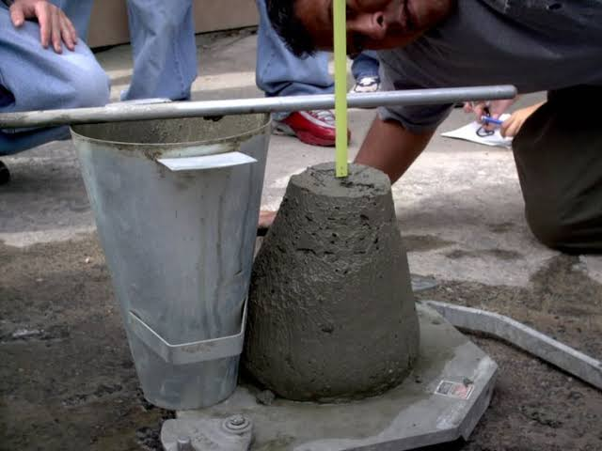
MIX PROPORTION OF CONCRETE.
The mix proportion with concrete demolition waste is done for M25 concrete for 50mm slump by trial.
WORKABILITY
SLUMP TEST
50mm
with and without steel fibers.

Slide 19
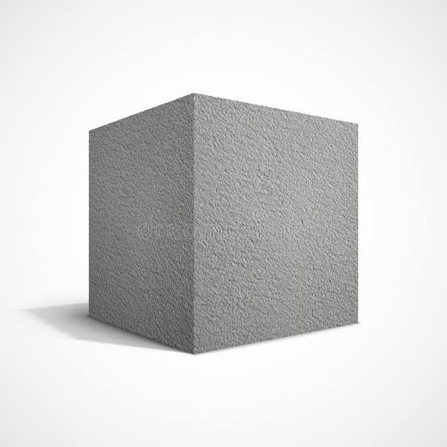
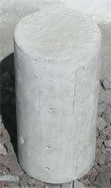
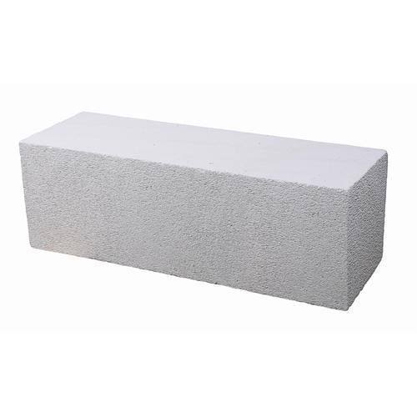
CAST AND TEST.
6 number of cubes, cylinders and beams will be cast without fibers.
6 number of cubes, 3 cylinders and 3 beams with steel fibers will be cast at 1,2 and 3 percentages respectively for each test by weight of concrete.
The cast specimens are cured, after curing the specimens are tested for 7days and 28 days.
Cube 150x150x150mm
Cylinder
150x300mm.
Beam
750x100x75mm.

Slide 20
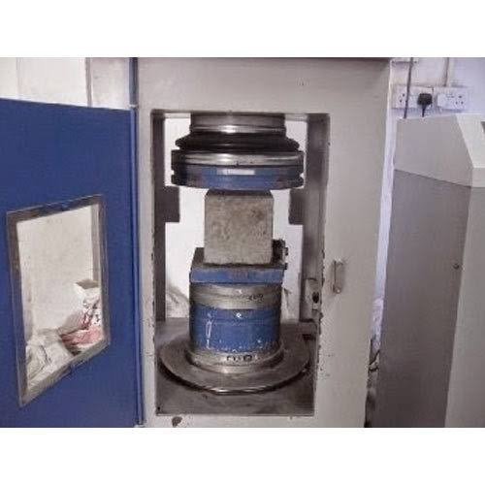
COMPRESSIVE STRENGTH TEST
The compressive strength test will be carried on cube size of 150×150×150mm. 3 number of cubes will be tested with steel fibers of 1%, 2% and 3% and 3 cubes without fibers for 7days and 28 days.
Compression test

Slide 21
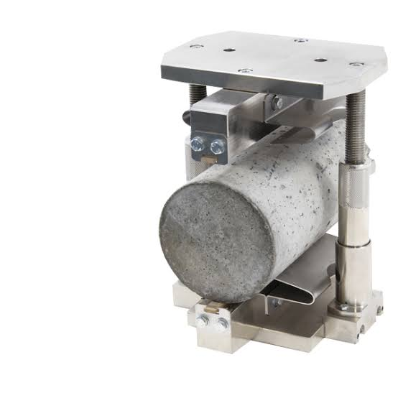
SPLIT TENSILE TEST .
The tensile strength test will be carried on cylindrical beam size of 150×300mm. 3 number of cylinders will be tested with steel fibers of 1%, 2% and 3% and 3 cylinders without fibers for 28 days.
Split tensile test

Slide 22
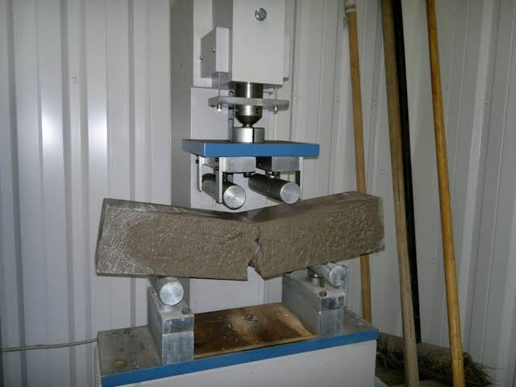
FLEXURAL TEST.
The flexural strength test will be carried on rectangular beam size of 750×100×75mm. 3 number of beams will be tested with steel fibers of 1%, 2% and 3% and 3 without fibers for 28 days.
Flexural test

Slide 23
TESTS ON MATERIALS
TEST ON CEMENT
Normal consistency of cement
Weight of cement = 200gm
Trial | Water (%) | Water (ml) | Initial reading (mm) | Final reading (mm) | Height not penetrated from bottom in (mm)

Slide 24
Initial setting time of cement.
Weight of cement = 200gm.
Water = 0.85P.
Sl no | Time in (min) | Initial reading | Final reading | Needle not Penetrated from bottom in (mm)
1
2
3
4
5

Slide 25
Specific gravity of cement.
Le-chateliers flask.
Wt of cement taken W = 64 gm.
Sl no | Initial reading | Final reading | Volume of cement (V) [vol of Kerosene displaced] | Specific Gravity G = W/V

Slide 26
Tests on fine aggregate from concrete demolition waste.
Specific gravity.
Sl no | Weight (gm) | Trial 1 | Trial 2 | Trial 3
1 | Weight of empty Pycnometer(W1)
2 | Weight of empty Pycnometer + FA (W2)
3 | Weight of empty Pycnometer + FA + water (W3)
4 | Weight of empty Pycnometer + water (W4)
5 | Specific gravity
Specific gravity = [W2-W1] / [(W4-W1) – (W3-W2)]

Slide 27
Fineness modulus of concrete demolition waste fine aggregate .
Weight of aggregate = 2kg
Sl no | IS Sieve(mm,µ) | Weight Retained(g m) | Cumulative Weight Retained(gm) | Cumulative Retained(%) | Cumulative Passing(%)
1 | 4.75
2 | 2.36
3 | 1.17
4 | 600
5 | 300
6 | 150
7 | Pan
Fineness modulus ∑ = (cum retained%) / 100

Slide 28
Tests on coarse aggregate from concrete demolition waste.
Specific gravity.
Sl no | weight (gm) | Trial 1 | Trial 2 | Trial 3
1 | Weight of empty Pycnometer(W1)
2 | Weight of empty Pycnometer + CA (W2)
3 | Weight of empty Pycnometer + CA + water (W3)
4 | Weight of empty Pycnometer + water (W4)
5 | Specific gravity
Specific gravity = [W2-W1] / [(W4-W1) – (W3-W2)]

Slide 29
Fineness modulus of concrete demolition waste coarse aggregate.
Weight of aggregate = 5kg.
Sl no | IS Sieve(mm,µ) | Weight Retained(g m) | Cumulative Weight Retained(gm) | Cumulative Retained(%) | Cumulative Passing(%)
1 | 80
2 | 40
3 | 20
4 | 10
5 | 4.75
6 | 2.36
7 | 1.18
8 | 600
9 | 300
10 | 150
Fineness modulus ∑ = (cum retained% + 500) / 100

Slide 30
Concrete demolition waste coarse aggregate impact test.
Test | Sample | W1 (gm) | Sieve for separating fines (mm) | W2 (gm) | Crushing Value (%)
 |  |  | 2.36
 |  |  | 2.36
 |  |  | 2.36

Slide 31
Concrete demolition waste coarse aggregate crushing test.
Test | Sample | W1 (gm) | Sieve for separating fines (mm) | W2 (gm) | Impact value Value (%)
 |  |  | 2.36
 |  |  | 2.36
 |  |  | 2.36

Slide 32
Concrete demolition waste coarse aggregate abrasion test.
Test | Sample | W1 (gm) | Sieve for separating fines (mm) | W2 (gm) | Crushing Value (%)
 |  |  | 1.18
 |  |  | 1.18
 |  |  | 1.18

Slide 33
Compression test.
Sl no | Mark on cube or cube designation | Date of casting | Date of testing | Area (mm²) | Load(P) kN | Compressive strength(N/mm²)
Compressive strength = P/A N/mm²

Slide 34
Split tensile test.
Sl no | Mark on cylinder/ cylinder designation | Date of casting | Date of testing | Load(P) | tensile strength (N/mm²)
Tensile strength = 2P / πDL N/mm²

Slide 35
Flexural test.
Sl no | Mark on beam / beam designation | Date of casting | Date of testing | Load(P) | Flexural strength(N/mm²)
Flexural strength = PL / bd² N/mm²

Slide 36
RESULTS and CONCLUSION.
Conclusion will be drawn from the test results obtained.

Slide 37
SCHEDULE OF LABORATORY WORKS.
Week – 1and 2.
Characterization of materials and selection of materials by trial mix.
Week – 3.
Design of M25 concrete mix for 50mm slump.
Week – 4, 5, 6 and 7.
Casting of cubes, cylinder and beams.
Curing.
Week – 8.
Testing cubes, cylinder and beams for 28days and analysis of results.

Slide 38
MATERIAL COST.
Sl.no | Material | Quantity | Amount
1 | Admixture Gelium | 1 liter | 2000 Rs.
2 | Steel fibers | 8 kg | 3000 Rs.
3 | Mould from laminated sheets of size 750×100×75 mm. | 9 nos | 8000 Rs.
4 | Cement of grade 43. | 3 nos | 1275 Rs.
Total = 14275 Rs.

Slide 39
References.
MEENU LATHA GOYAL , [Urban-ACE-2019], in paper titled ‘Deconstruction and material reuse” , published “National seminor on C&D wastes”,[Urban-ACE-2019]
Chanki Nasirhusen M'. Dr. Jayeshkumar R. Pitroda, in their Paper titled, “A critical review on construction waste management”, published , “international journal of advance engineering and Research Development”, ISSN-2348-6406, [2018].
Sastry K, Suresh B,et al(2018),in their Paper, ‘Experimental study of fiber reinforced concrete waste with recycled aggregates”, published, “Technical research organization of India”, ISSN-2393-8374,[2018].,
Gourav Gupta'. Sameer Malhotra,et al(2018),in their Paper, “A case study on fiber reinforced concrete”, published , “international journal for applied science and engineering technology”, ISSN-2321-9653, [2018].
Ankur Yaday'. Satish Parihar,et al (2018),in their Paper, “A review on steel fiber reinforced concrete”, published , “International engineering science advance research”, ISSN-2395-0730, [2018].
Pramod Kawde , Abhijit Warudkar,et al (2017),in their Paper, “Steel fiber reinforced concrete A review”, published “international journal of engineering sciences & research technology”,ISSN-2277-9655,[2017].

Slide 40
THANK YOU

Slide 43
ABSTRACT
Use of conventional concrete has been rapidly increased in past decades. Due to durability problems and remodeling of structures large quantity of demolition waste are generated and also during construction Brick waste are also generated.
Disposal of these wastes causes environmental impact. These waste has to be recycled and used in construction to avoid environmental problems.
In this study an attempt has been made to design M20 grade concrete using waste brick powder with different percentages and the behavior of waste brick powder is studied.
The results of compressive test, split tensile test are compared with waste brick powder and without waste brick powder.

Slide 45
LITERATURE REVIEW
This chapter deals with the brief review of available literature on partial replacement of fine aggregate using waste brick powder and also about its relevant topics, to understand and analyze the latest methodologies adopted in the studies conducted by various authors.
Farid Debieb (2007): This paper examines the possibility of using crushed brick as coarse and fine aggregate for a new concrete. Either natural sand, coarse aggregates or both were partially replaced (25, 50, 75 and 100%) with crushed brick aggregates.
J. Martina Jenifer, Et al., (2016): This study aimed to investigate the suitability of using crushed brick in concrete. Crushed brick originated from demolished masonry was crushed in the laboratory and added partial sand replacement. Three replacement levels, 15%,20% and 25%, were compared with the control. The tests on concrete showed that the mechanical properties (compressive, flexural and splitting tensile strengths) of concrete containing crushed brick were well comparable to those of the concrete without ground brick.

Slide 47
Diniya David, Et al., (2017): In this present experimental investigation, the cellular property is achieved by addition of aluminum metal powder in varied percentages such as 0.5, 1, 1.5, 2, 2.5, and 3%. Crushed clay brick is used as replacement of conventional fine aggregate with varied percentages such as 10, 20,23,25,27 and 30% in each percentage of cellular concrete.
Shruthi H G, Et al., (2017): This study aimed to investigate the suitability of using crushed brick in concrete. Crushed brick originated from demolished masonry was crushed in the laboratory and added partial sand replacement. Five replacement levels, 10%,20% ,30%,40%, 50%, were compared with the control. The tests on concrete showed that the mechanical properties (compressive strengths) of concrete containing crushed brick were well comparable to those of the concrete without ground brick.

Slide 49
Anayat Ali, Et al., (2019): This research review will discuss the partial replacement of fine aggregate with brick dust and how to reduce the dependency on the natural resources such as sand used as fine aggregate and provide a new way to dispose of waste brick debris. Different replacement levels 10%, 15%, and 20%, will be checked. Different tests showed that the compressive strength is enhanced by using optimum percentage replacement of natural fine aggregate with brick debris compared to conventional mortar and concrete.
Khairunisa Muthusamy, Et al., (2020): This research examines the effect of palm oil clinker as partial sand replacement on properties of fly ash cement sand brick. Five brick mixes were prepared using fly ash blended cement as the binder. Other mixes were produced by varying the quantity of pulverized palm oil clinker ranging from 0%, 10%, 20%, 30% and 40% by weight of sand. All specimens were water cured for 28 days.

Slide 50
S.M. Basutkar, Et al., (2020): In this present investigation, paver blocks for pedestrian traffic are produced using C and D brick waste aggregates as a replacement for fine aggregates (MSand). The crushed brick masonry waste (fine aggregates between 150m and 4.75 mm) was used as replacement for fine aggregates at 25%, 50% and 75%. The fines content (fine aggregates < 150m) in the mix composition were varied at 10%, 20% and 30%. The compressive strength test for Recycled Aggregate Paver Blocks (RAPB) was evaluated at 7, 14, 21, 28 and 90 days of curing.
Juntao Dang, Et al., (2020): This paper studied the effect of replacement levels of sand aggregates (SA) by recycled brick aggregates (RBA) at 0%, 50%.
Mane Rainia, Et al., (2020): This paper aims to determine the feasibility of using waste from rejected concrete specimens by civil engineering laboratories combined with waste brick, as an alternative of natural fine aggregate in the production of cement mortar. Natural fine aggregate has been replaced by recycled fine aggregate (RFA), at 0%, 15 %, 30 %, 45 %, and 90 %, by weight.

Slide 51
R. Veerakumar, (2018): This study aimed to investigate the suitability of using brick debris in concrete in place of fine aggregate. Brick debris originated from demolished masonry walls crushed in the laboratory and added in partial fine aggregate replacement. Four replacement levels, 5%, 10%, 15%, and 20%, were compared with the control. The tests on concrete showed that the mechanical properties (compressive strength test) of concrete containing brick debris were well comparable to those of the concrete without ground brick.
Awadhesh Chandramauli, Et al., (2018): This research able to reduce the dependency on sand and open a new option to dispose of waste fire bricks. Partial replacement is done at 0%, 22%, 25%, 28% and 31% in this project. The test result says the 28% replacement gives the maximum tensile strength.

Slide 52
Mane Rainia, Et al., (2020): This paper aims to determine the feasibility of using waste from rejected concrete specimens by civil engineering laboratories combined with waste brick, as an alternative of natural fine aggregate in the production of cement mortar. Natural fine aggregate (NFA) has been replaced by recycled fine aggregate (RFA), at 0%, 15 %, 30 %, 45 %, and 90 %, by weight.
Qian Huang, Et al., (2020): The waste clay brick (WCB) was crushed and used as the fine aggregates to produce recycled mortars with sufficient workability (i.e. high water-cement ratio of 0.6). Two curing conditions (air and standard) and two statuses of WCB (dry and pre-soaking) were considered in this study. It was found that the recycled mortars with the dry WCB had relatively higher mechanical properties and lower water absorption but a converse tendency for pre-soaking WCB mortars, regardless of the curing conditions.

Slide 53
CONCLUSION OF LITERATURE REVIEW:
A comprehensive review of literature covering papers from Journals and conferences was carried out: papers reviewed were predominantly based on Waste brick powder.
The literature review indicates that very few publications are available on the waste brick powder, Variables aspect ratio such as, different grades of concretes and different percentages of brick powder are simultaneously covered in papers reviewed.

